Slide 1

Time For A Change!
Andrew Pfeifer

Slide 2

Proposal
Less people are paying high cable bills for entertainment purposes.
Streaming platforms are on the rise.
Increase profits by freeing server space for more TV series.

Slide 3
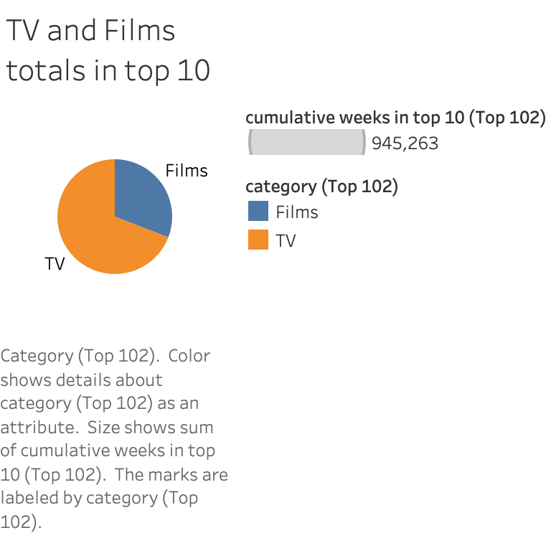
Why tv series
Between all countries, TV series are in the top 10 rankings more than 60% of the time compared to movies.
This information is from the recent rankings of all countries,

Slide 4
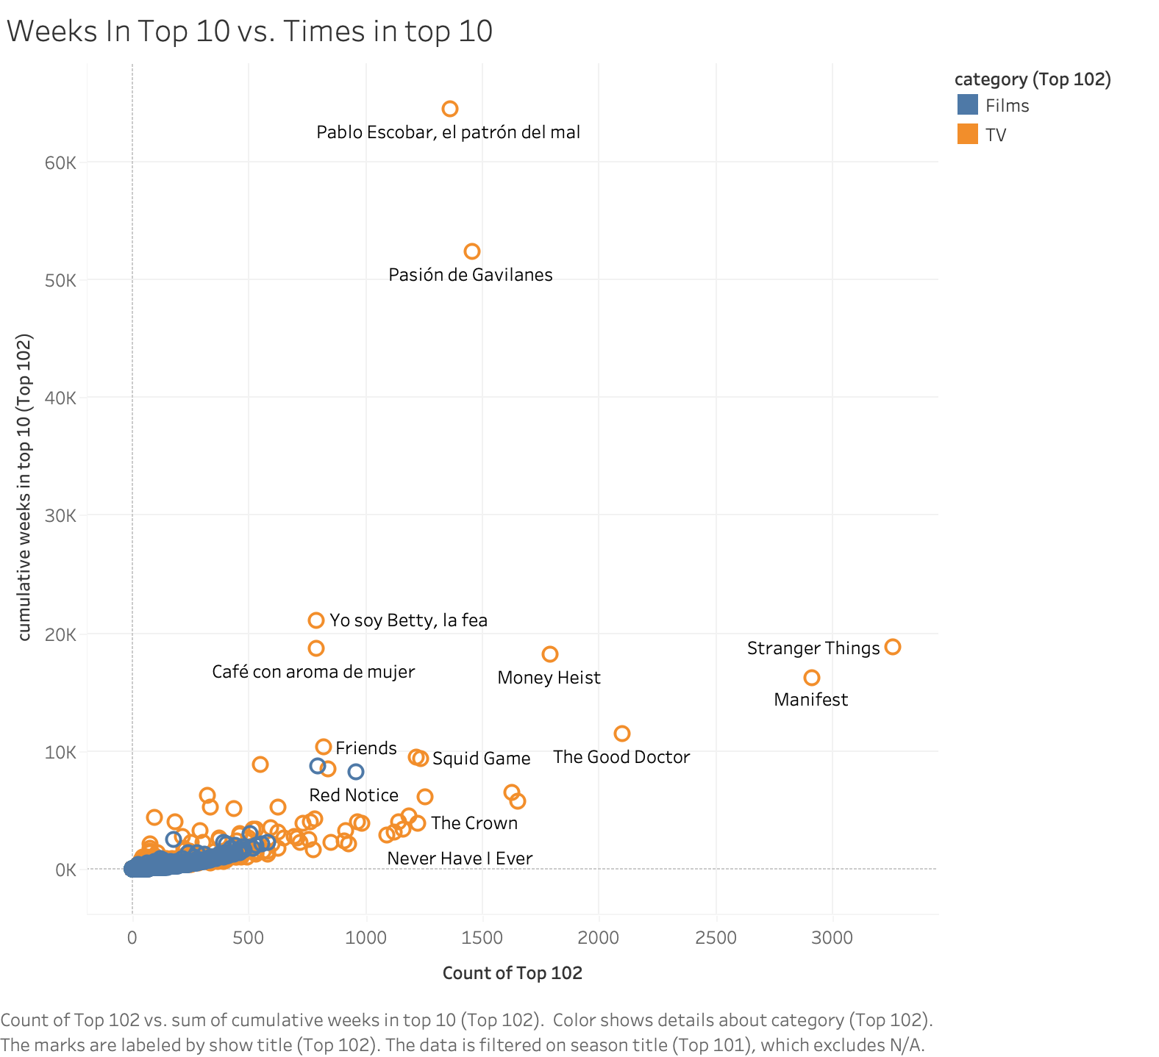
Why TV Series cont.
Ignoring the outliers, it’s seen that tv series have a positive correlation with top ten rankings.
The tv series that have the most amount of time in the top 10 are true crime series and sci-fi series.
Spanish language TV series rank high as well.

Slide 5
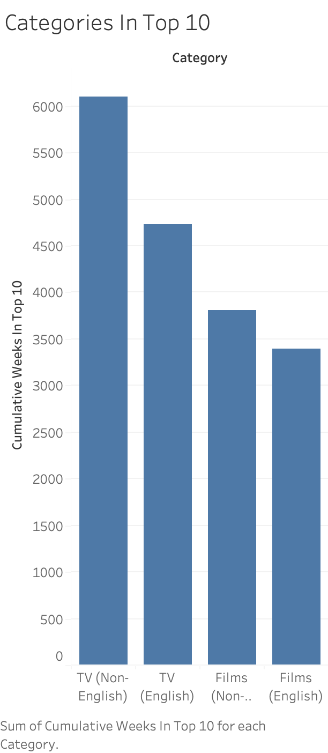
Top 10 worldwide
There are not as many movies in the top 10 when compared to English and non-English TV series.
Non-English TV series are in the top 10 more often than English TV series.

Slide 6
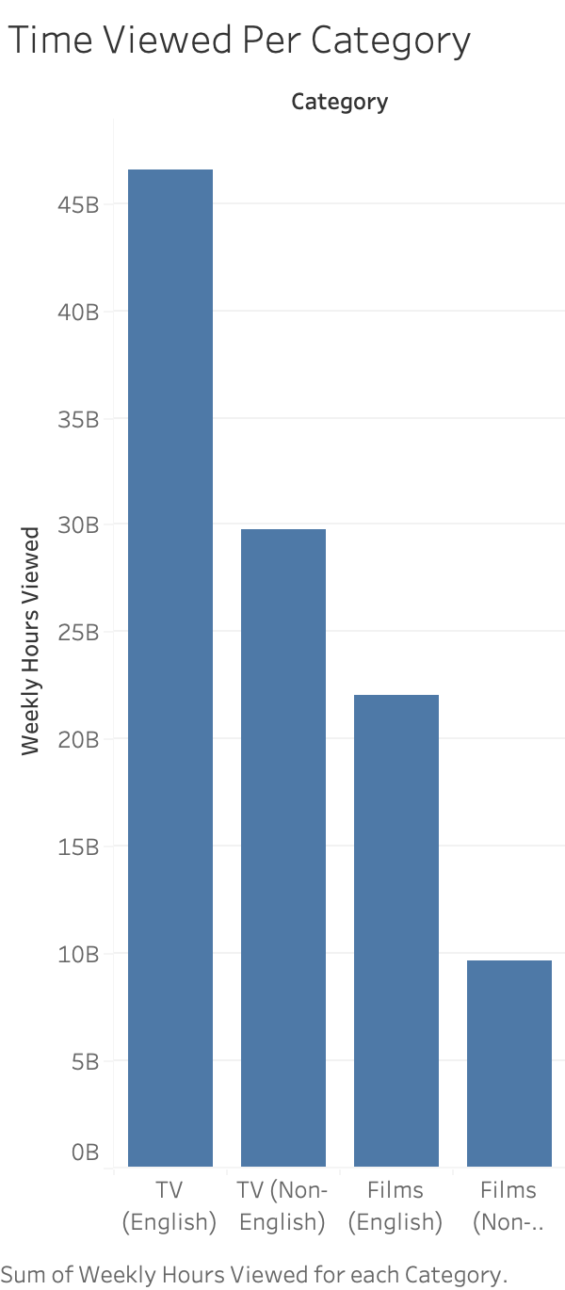
Top 10 Worldwide cont.
Per week, people spend more time watching English TV series on our platform.
Non-English Films take the place for the least watched on a weekly basis.
The best performing categories in the platform belong to TV series.

Slide 7
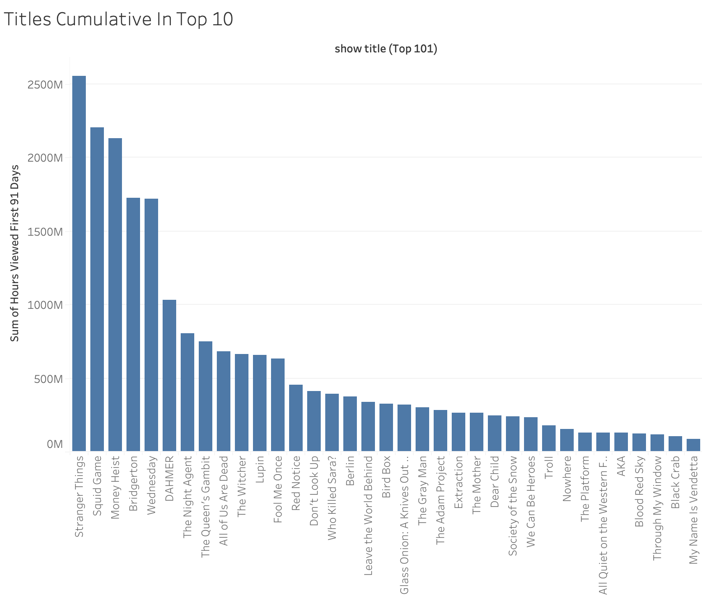
Weekly views by title.
Most people tend to watch more Sci-Fi and True Crime TV series.
Mixed among these are familiy And Korean TV shows (with English Dubs) like All Of Us Are Dead.
The least hours viewed are movies.

Slide 8
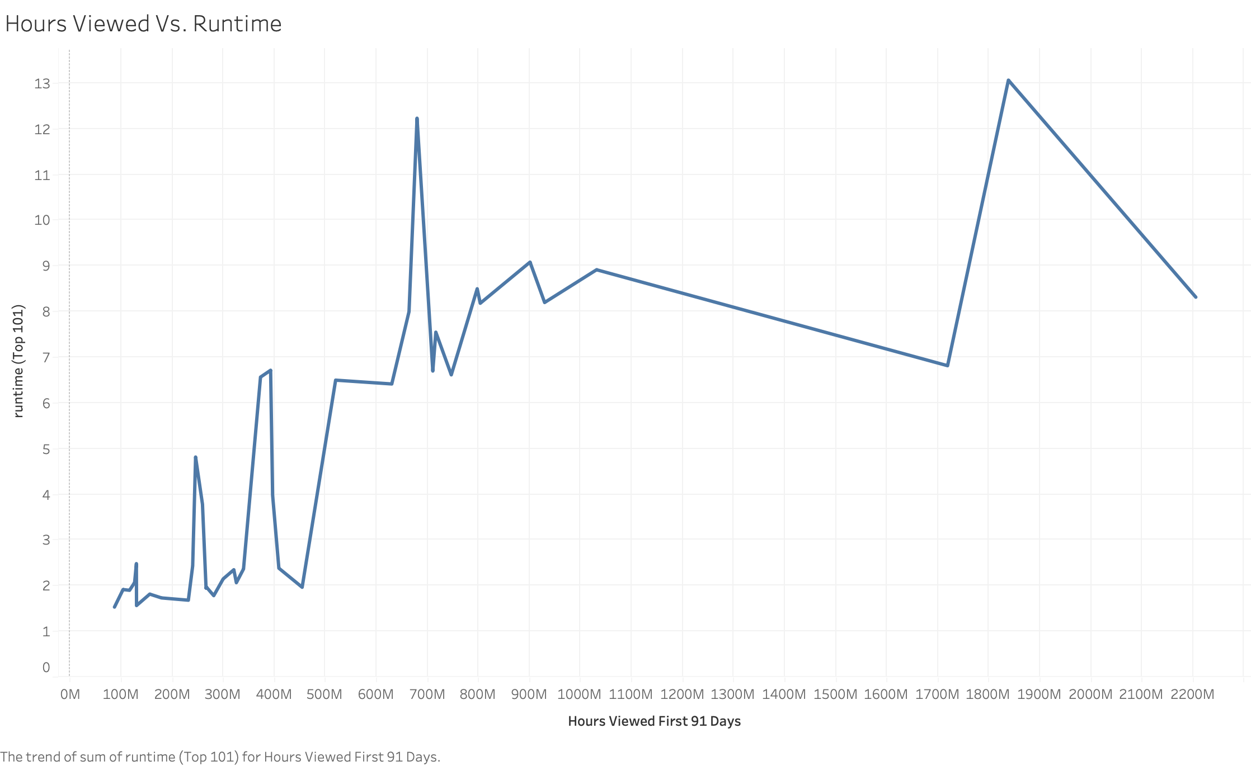
Hours viewed and run time.
There is a positive correlation with run time and the hours viewed.
Runtime provides more opportunity for ad placement.
Increased ad placement will lead to more profit or increases in upgraded memberships to remove ads.

Slide 9
Conclusion
More TV Series are watched on our platform as opposed to Movies.
Non-English series rank in the top ten more often.
We receive more views if a series has a longer runtime.
TV series with longer run times offer more opportunity for ad placement for the accounts that pay less and watch ads.
An increase in TV series (Multi-language Dubbed) will lead to an increase in upgraded memberships or additional profit from ads.

